Slide 1
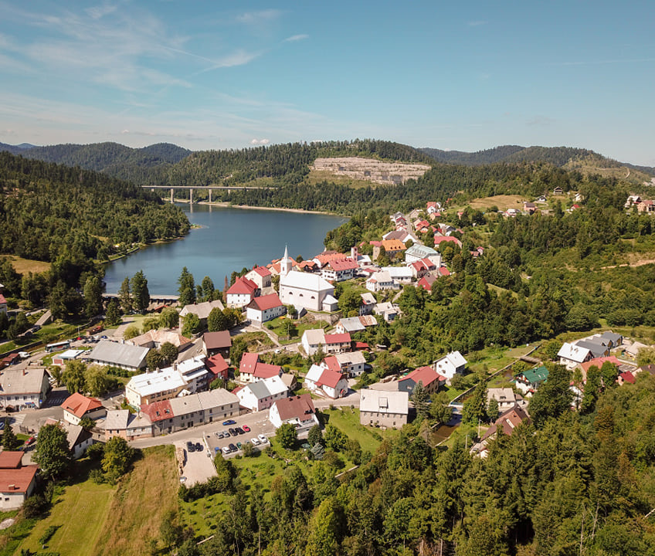
OŠ Ivanke Trohar, Fužine
Think globaly, act locally.

Slide 2
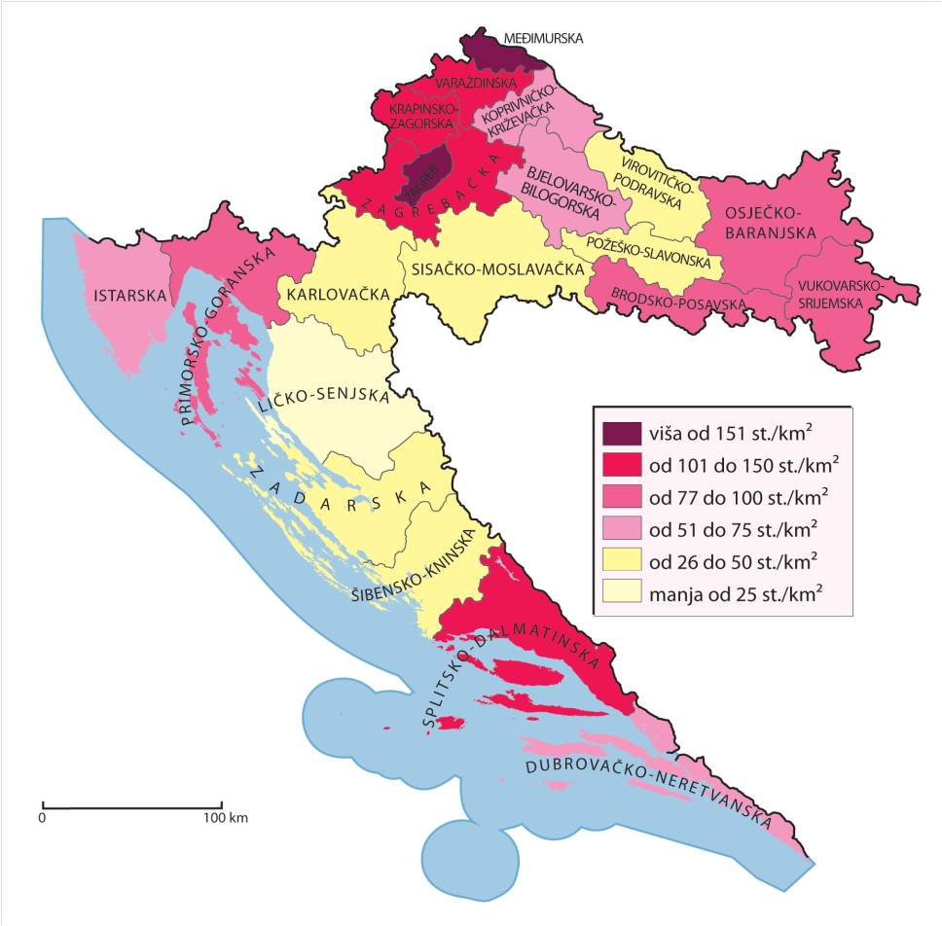
Geographical location of the school
Primorsko-goranska županija (PGŽ)
Gorski kotar (21,2 st/km2)
Gorski kotar - video
PGŽ
GK

Slide 3
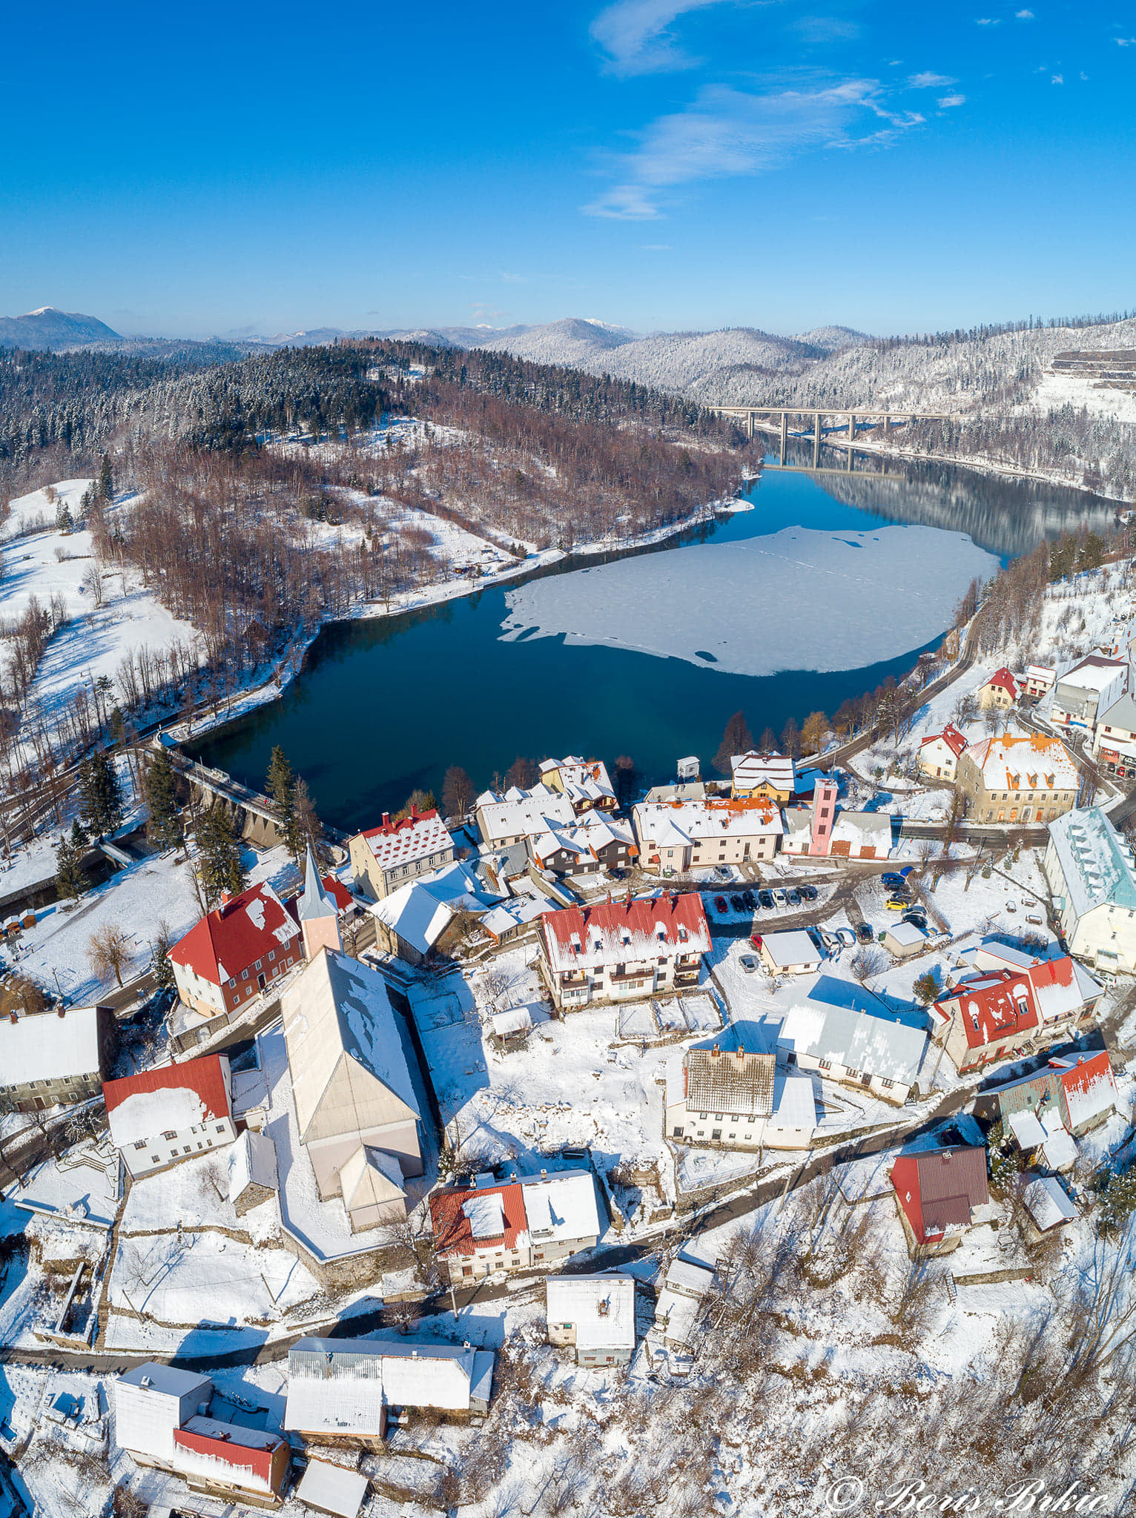
Fužine Population (2011.): 1592 Area‎: ‎86 km²
Elevation: 722 m
Fužine - video

Slide 4
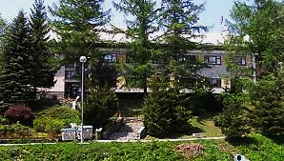
About our school…
Number of students in school year 2021./22.
Class | Number of students
1. | 7
2. | 8
3. | 7
4. | 11
5. | 6
6. | 12
7. | 12
8. | 10
Total number of students | 73

Slide 5
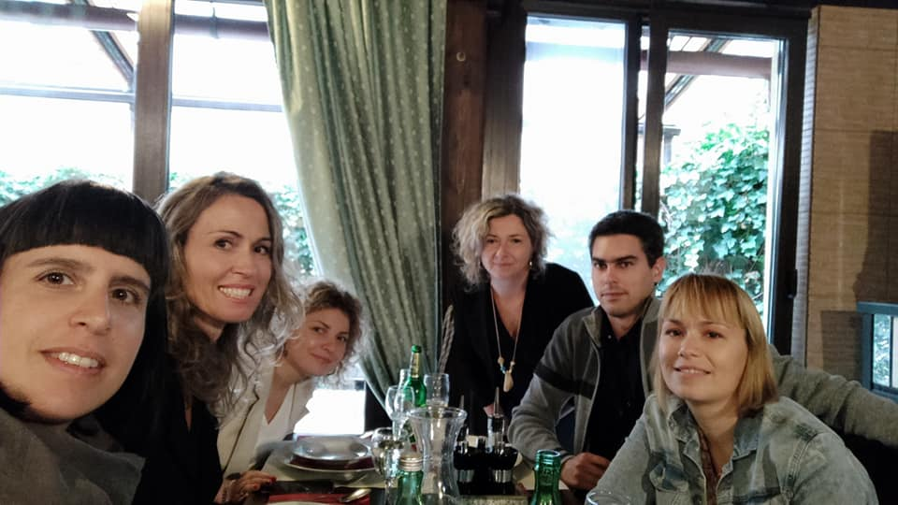
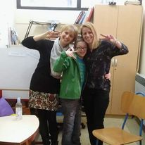
Works in one school | Works in two schools | Works in three schools
7 | 10 | 4
21
Number of teachers and professional associate
Works in one school | Works in two schools | Works in three schools
- | librarian | psychologist
- | 1/2 | 1/3

Slide 6
We are recording a declining trend in the number of students

Slide 7
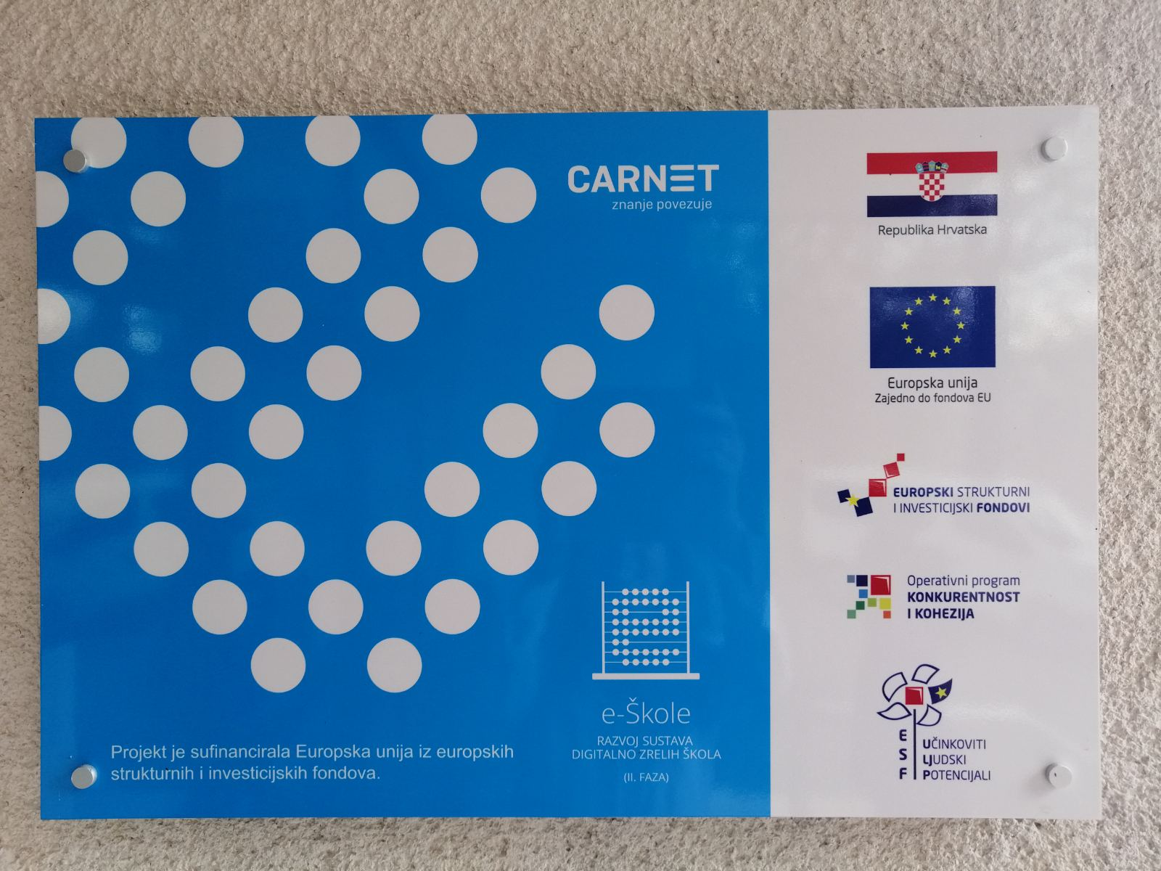
We are small school but we are hardworking!
Our teachers are very active in eTwinning projects We are the winners of the European label of excellence and quality for projects: „Let’ s have a cup of tea”, „Let’ s play with language”, „100. day of school”,
„20 days of kindness”, …

Slide 8
Film crew „Krešo Golik” has been active since 2009. We made around 10 short movies awarded at children film festivals at the national and international level

Slide 9
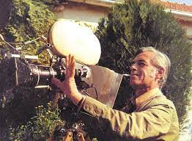
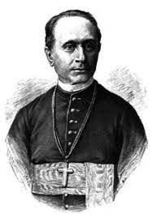
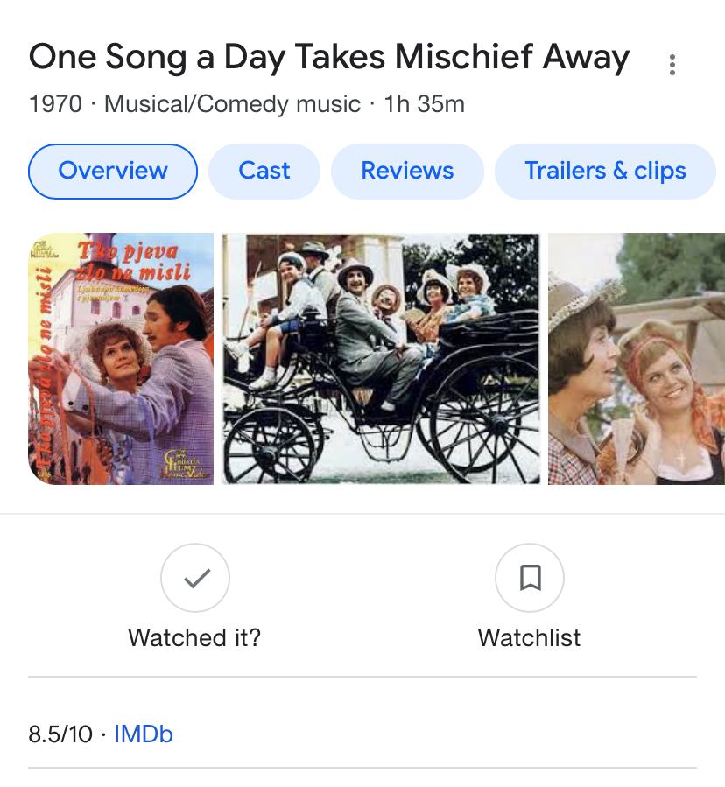
We are proud to our locals
KREŠO GOLIK (1922.. -1996.) movie director („Tko pjeva zlo ne misli”)
Dr. FRANJO RAČKI (1828.. -1894.) historian, publicist, politician

Slide 10
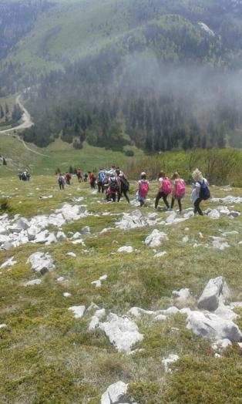
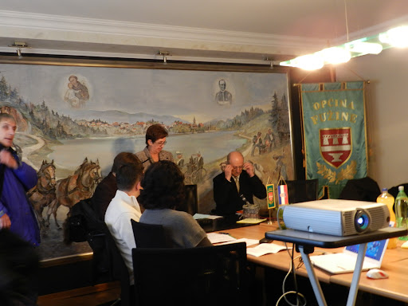
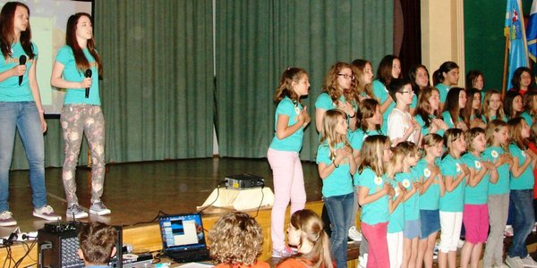
Other projects, programs and competitions...
Field teaching (NP Velebit)
Life skills training
A school without violence
CAP program
Days of Franjo Rački
Days of Krešo Golik
Student cooperative "Ivančica"
Unconventional natural food sources fair
Student’s choir "Ivančice"
School in nature
Science to young people – scientific competitions
Sports competitions (Erste blue league, chess...)
Days of Franjo Rački
Days of Krešo Golik

Slide 11
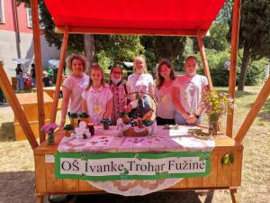
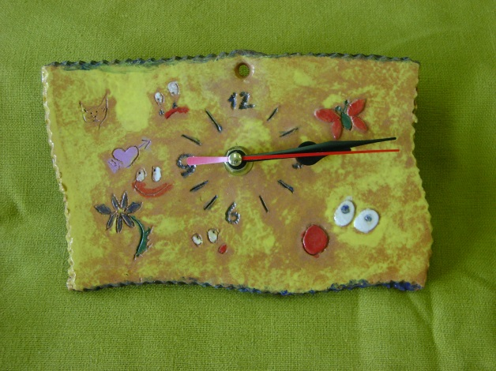
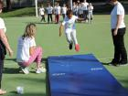
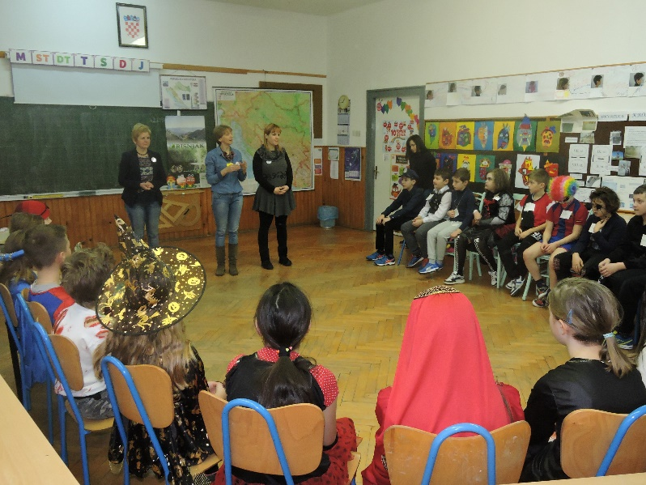
Photographs - Other projects, programs and competitions...
Unconventional natural food sources fair
Student cooperative "Ivančica"
Chess tournament
CAP program
Olympic Day

Slide 12
Popularization of science and mathematics

Slide 13
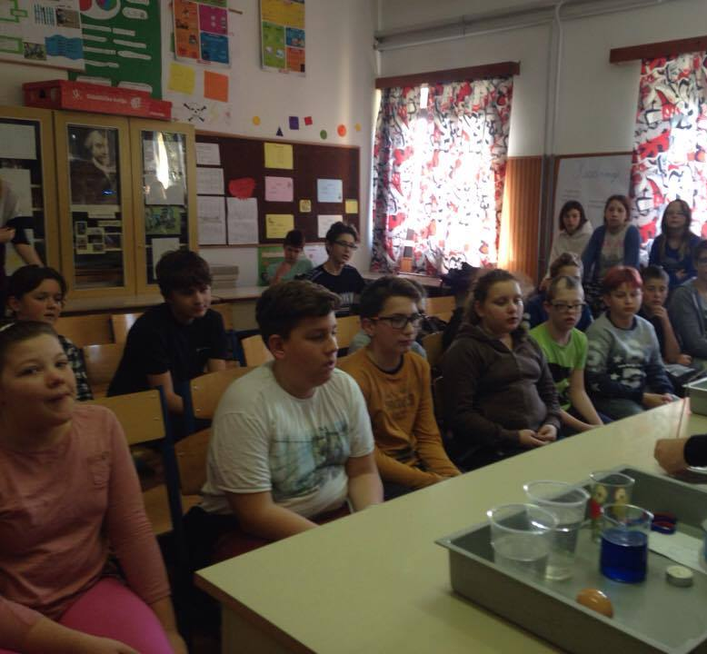
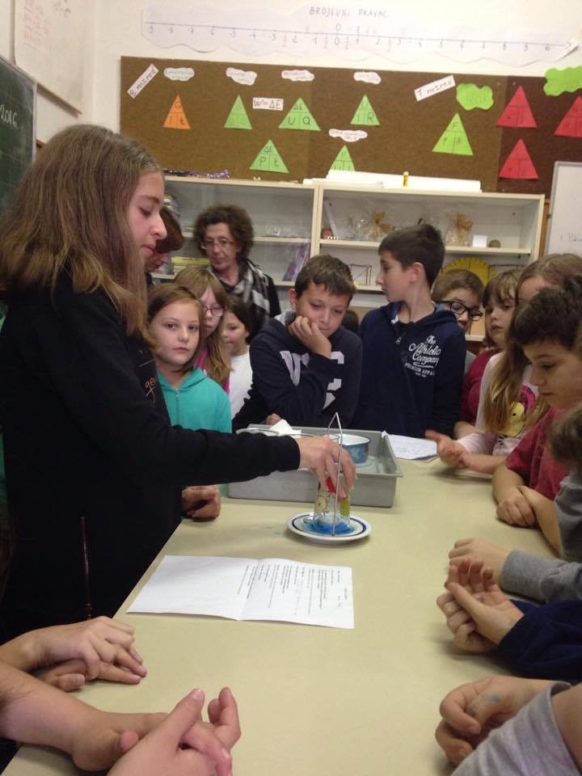
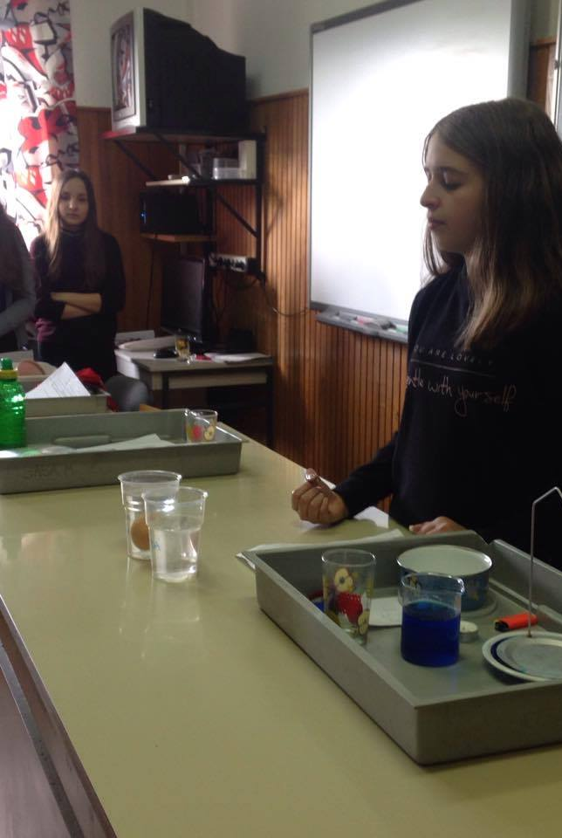
Celebrating World Science Day with physics experiments

Slide 14
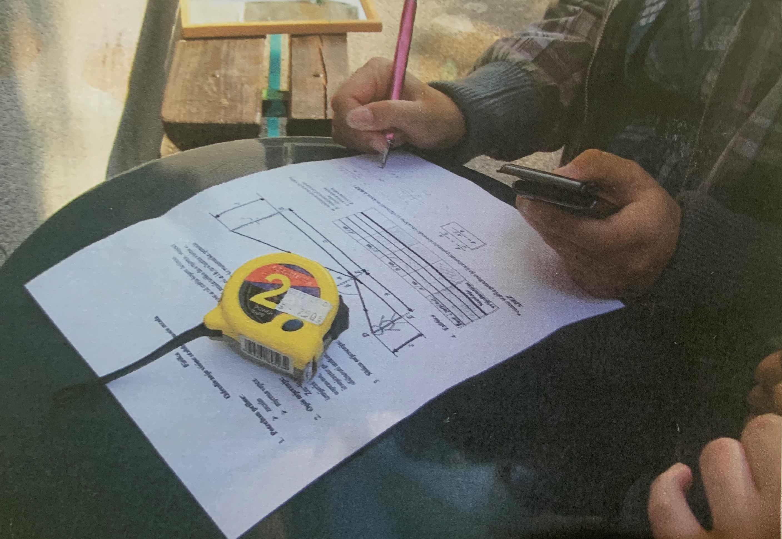
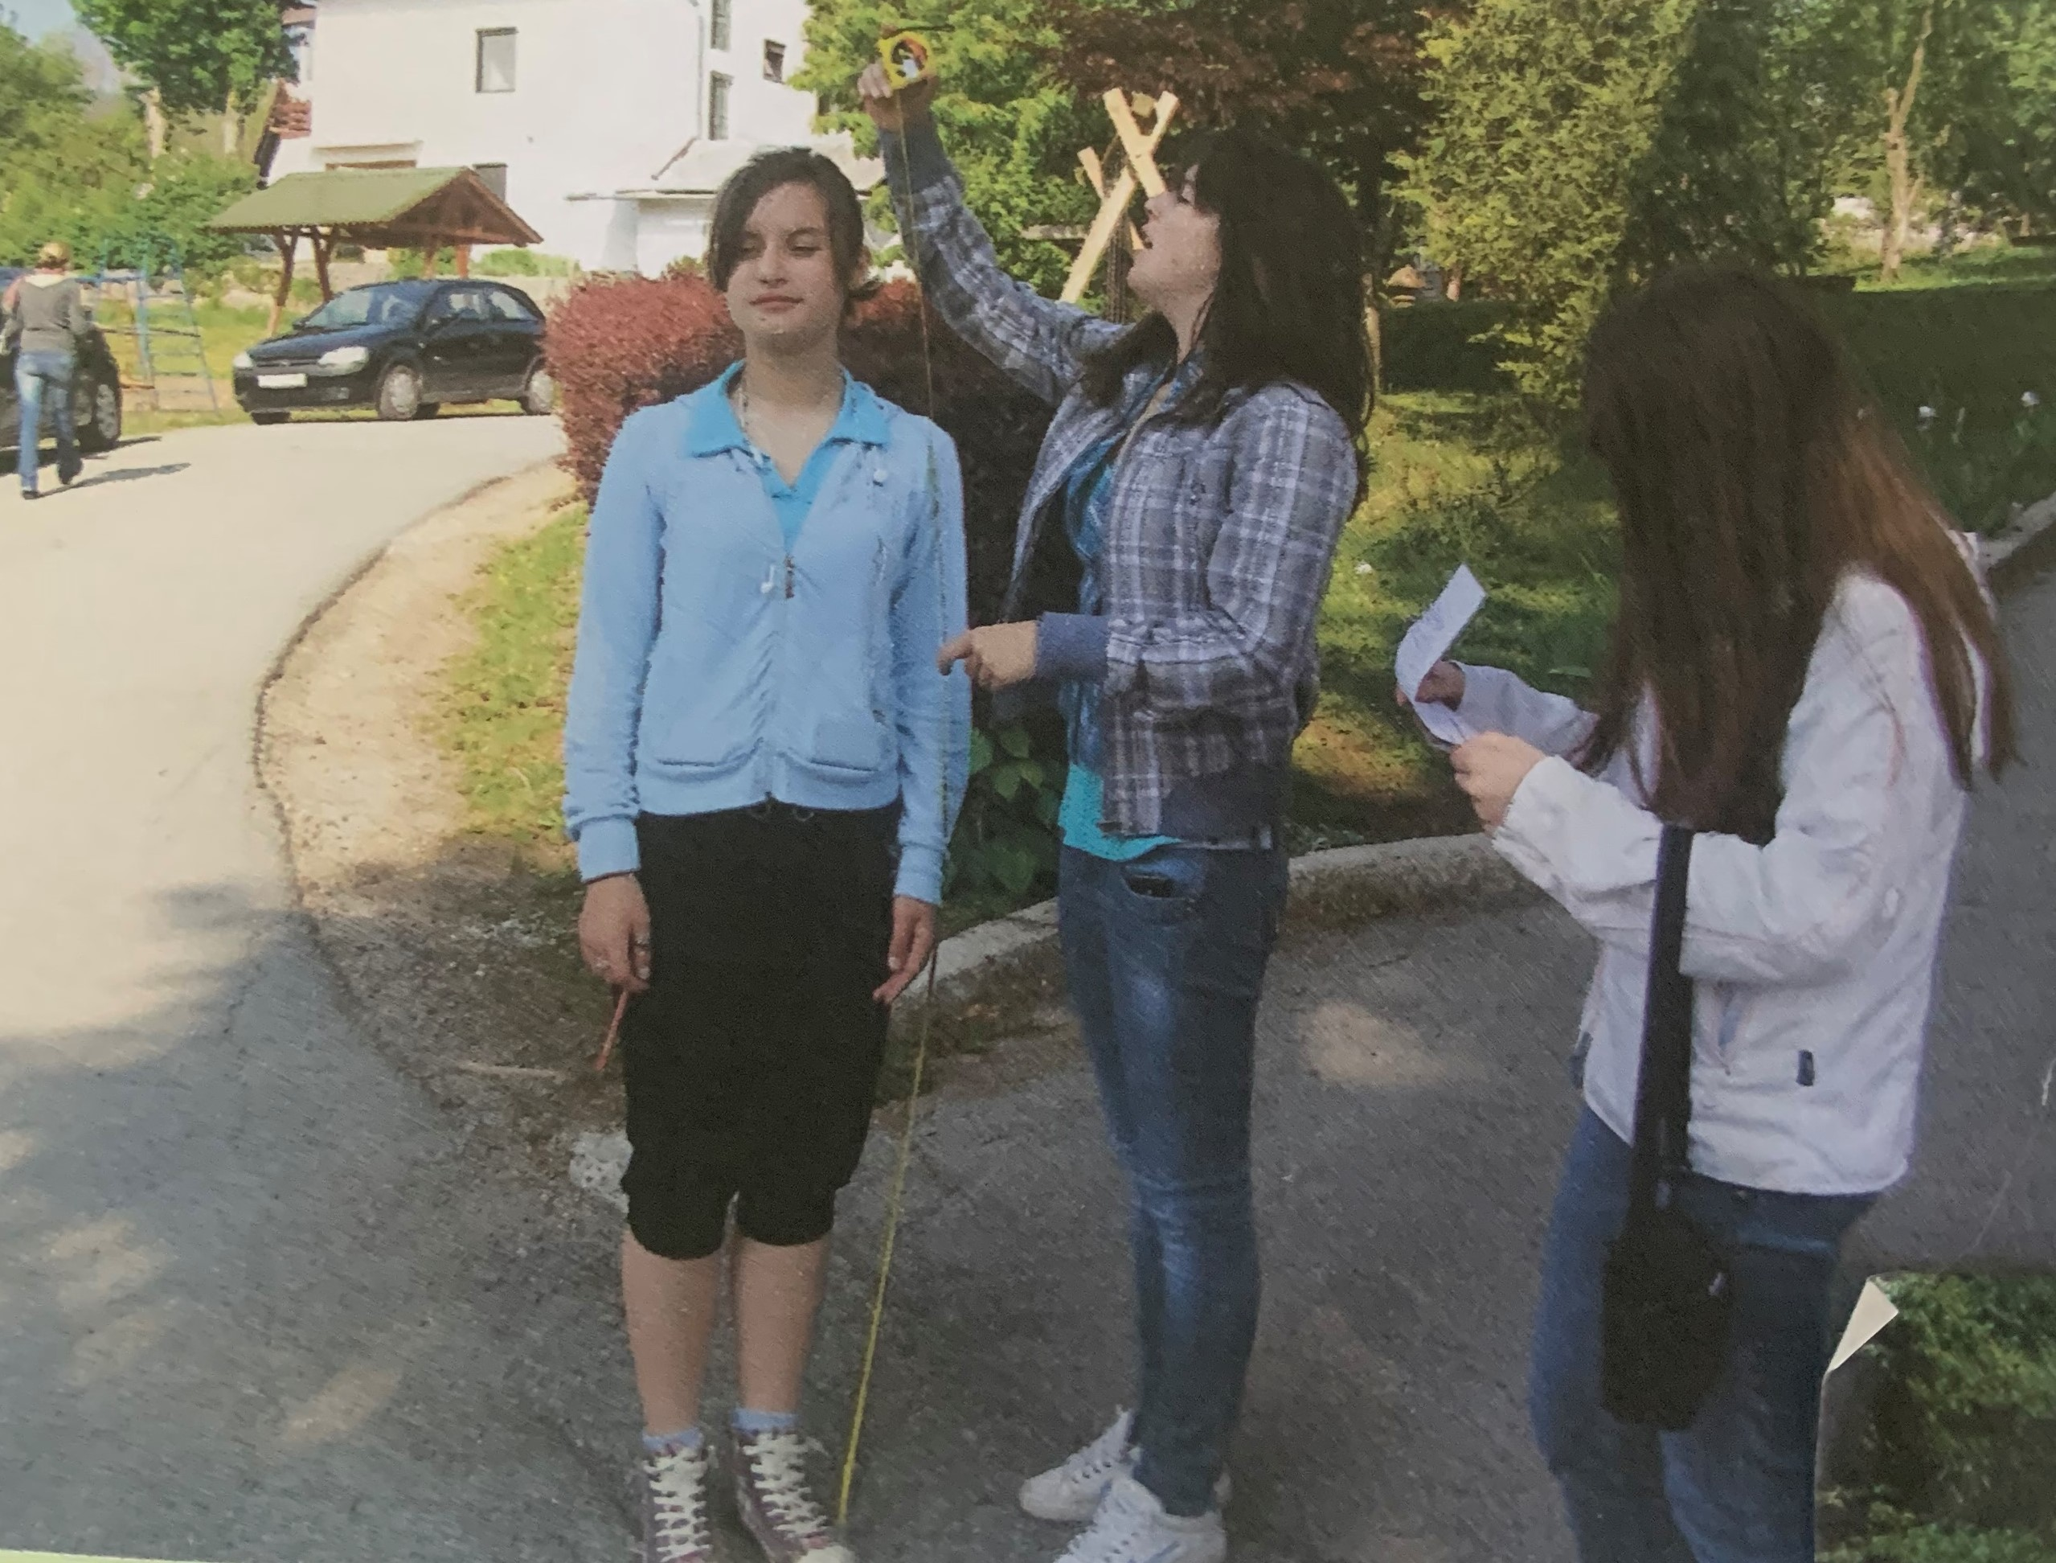
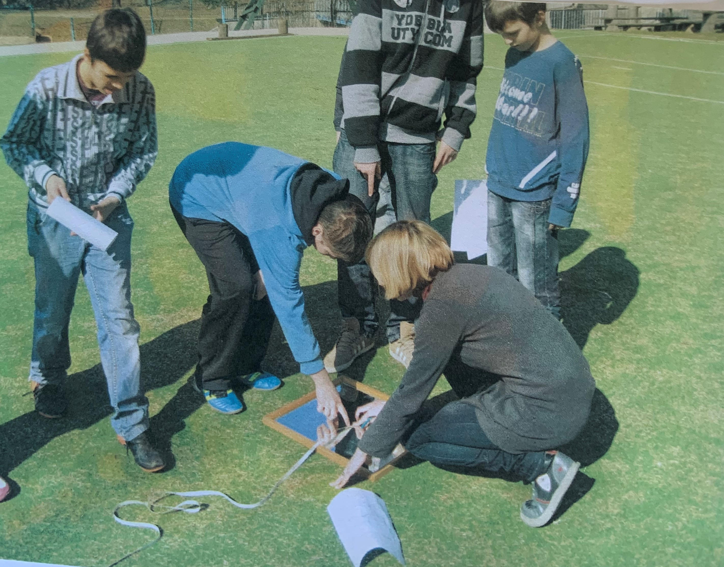
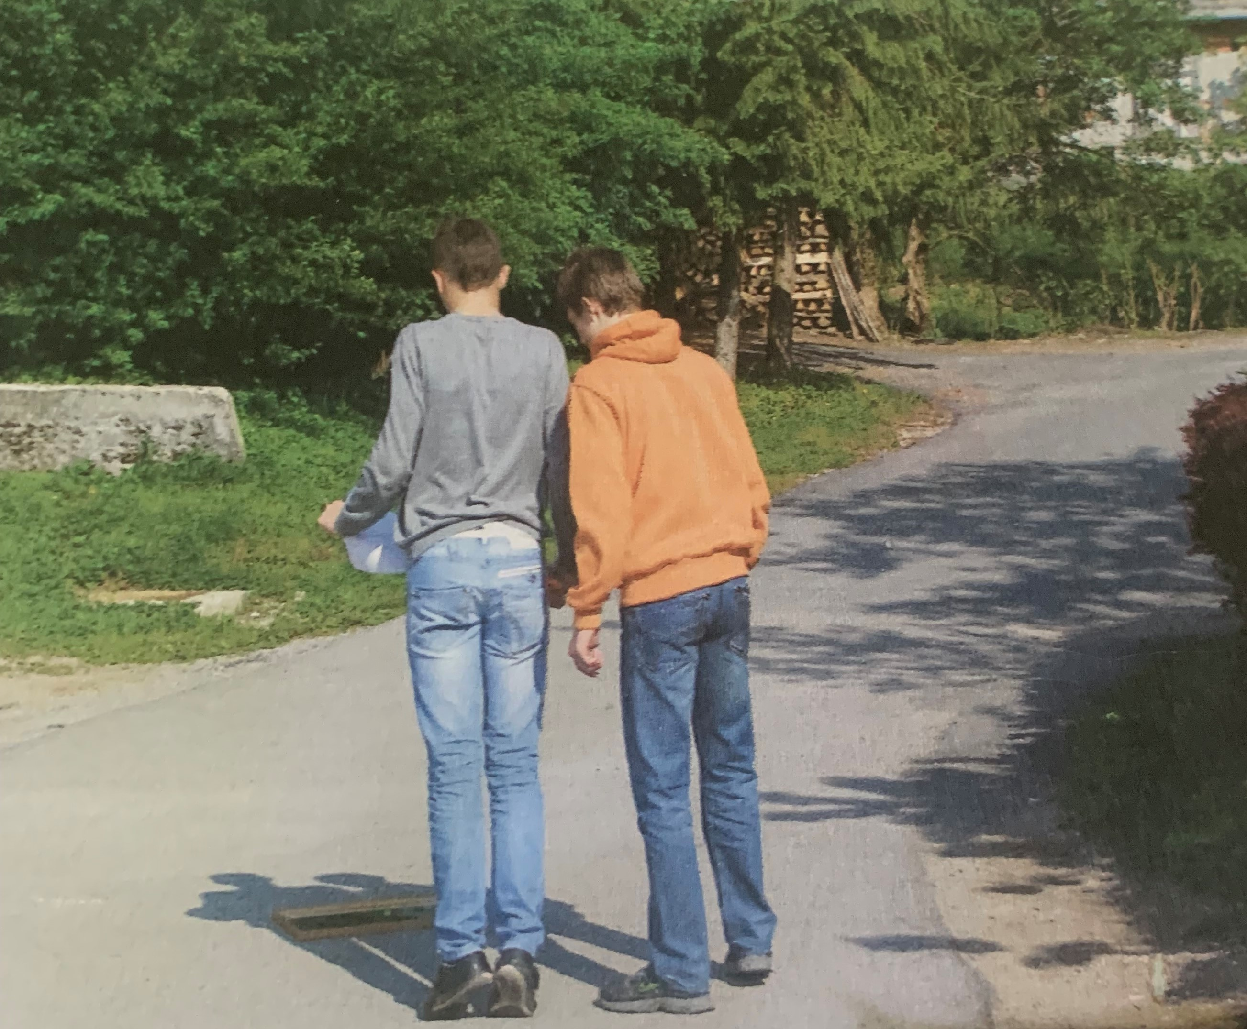
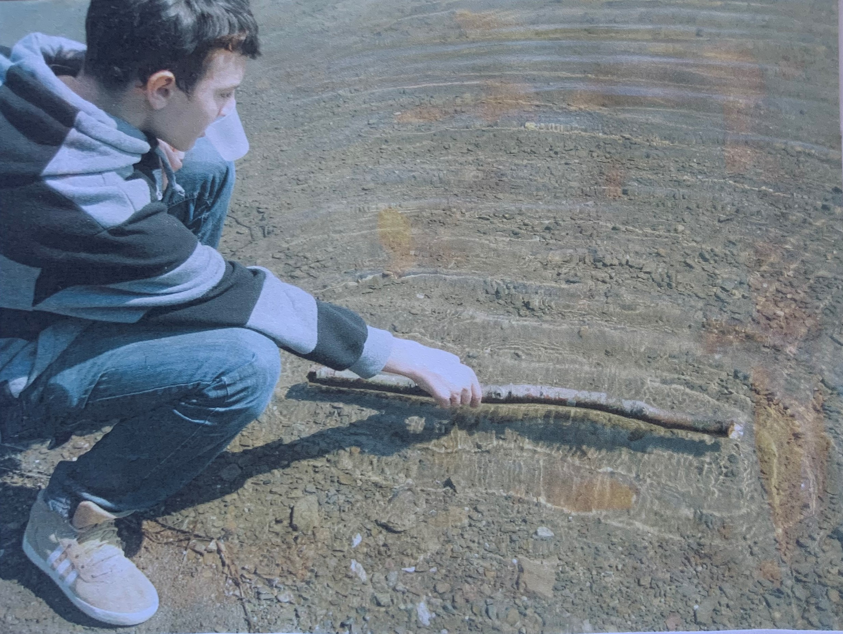
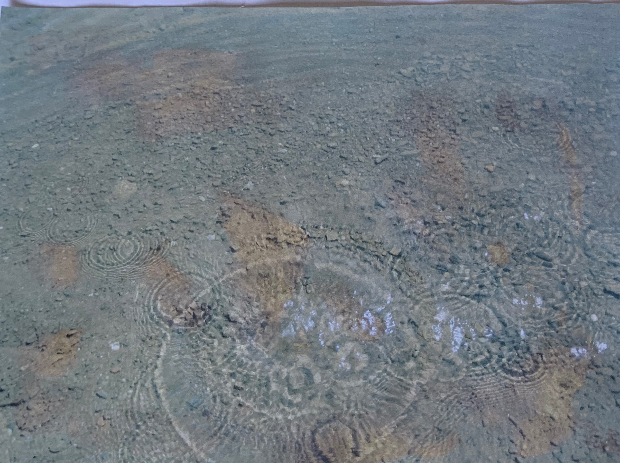
Physics in nature
Measuring the height of the tree
Observing waves on water

Slide 15
General success at the end of the school year
Class | Everage grade
1. | 4,88
2. | 5,00
3. | 4,55
4. | 4,67
5. | 3,77
6. | 3,80
7. | 4,30
8. | 4,67

Slide 17
Thank you for your attention!
Adriana Moras, prof.

Slide 18
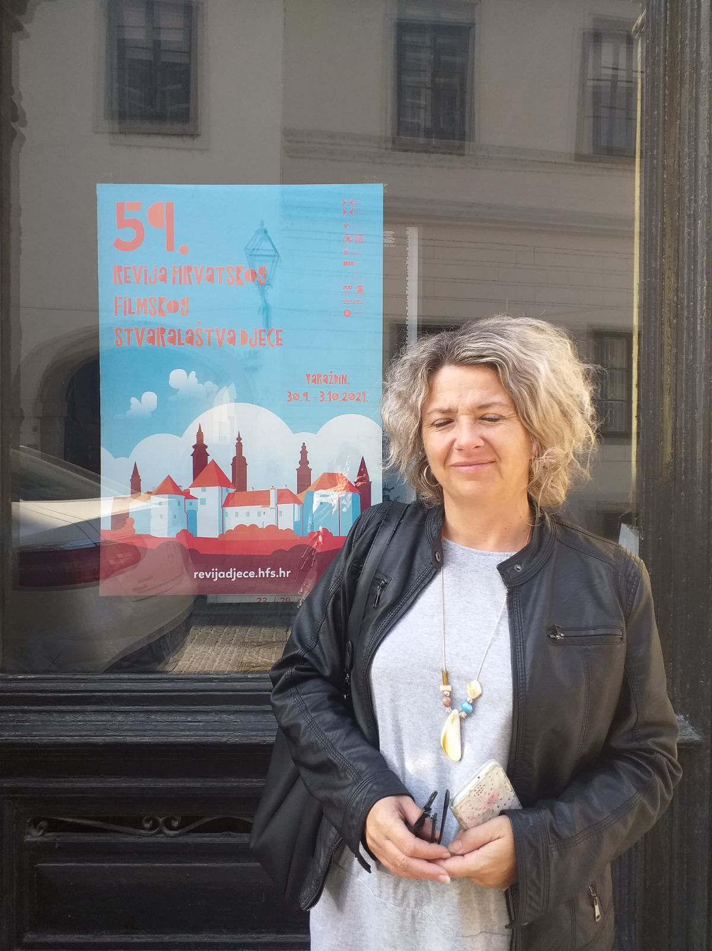
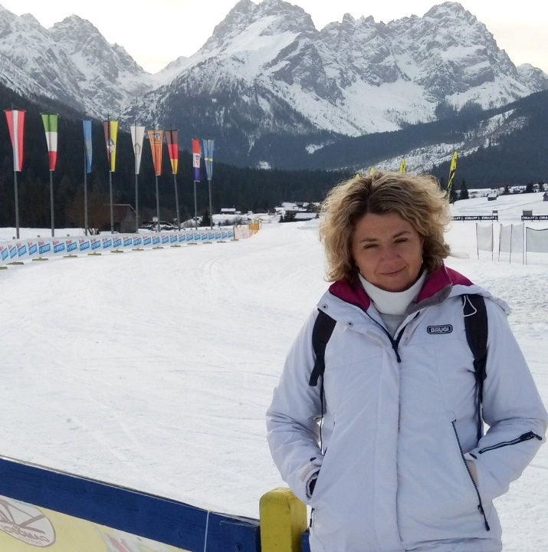
Elementary School Ivanke Trohar, Fužine
Adress: Breg 124a, 51322 Fužine
E-mail: ured@os-itrohar-fuzine.skole.hr
Tel. / Fax.: +385 51 835 167 www.os-itrohar-fuzine.skole.hr
School principal: Jasna Štimac, prof.

